Slide 1
LEO CHOCO COFFEE BAR
SUBMITTED BY
A.YAMUNADEVI

Slide 2
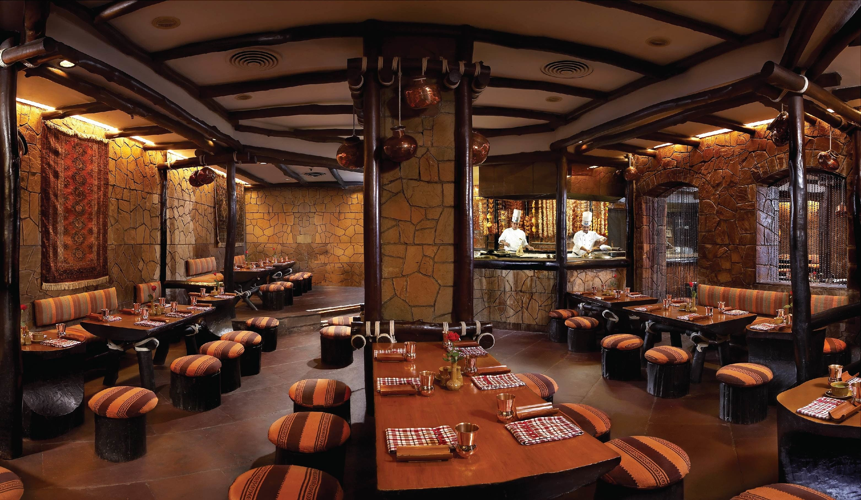
INTRODUCTION
The Leo Choco Coffee Shop Management is based on a concept to maintain orders , booking and management of a particular coffee shop. The Leo Coffee Shop Management System is a web-based project. The Aim of Leo Coffee Shop Management is communication between rural area people and coffee shop management.

Slide 3
OBJECTIVE: -
To develop a web-based system that will help to manage the orders and room booking
It takes the suggestion from the user.
This system is helpful for rural area people.
It takes less processing time.
To provide the fresh coffee, foods and rooms to the people.

Slide 4
Existing system: -
Slow data processing.
Not user friendly.
No more order for the product and benefits are less.
Wastage of paper

Slide 5
MODULES
ABOUT
LEO MENUS
BOOKING
CONTACT US

Slide 6
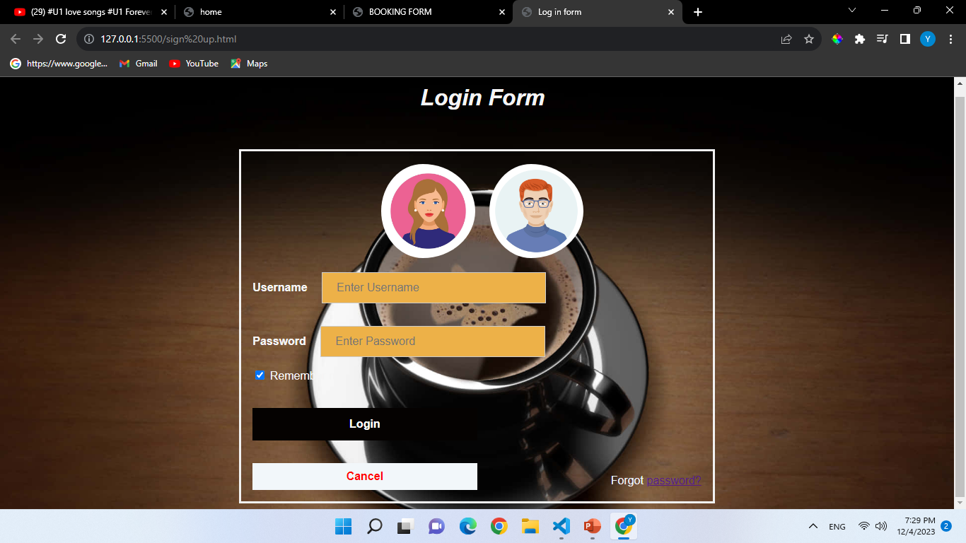

Slide 7
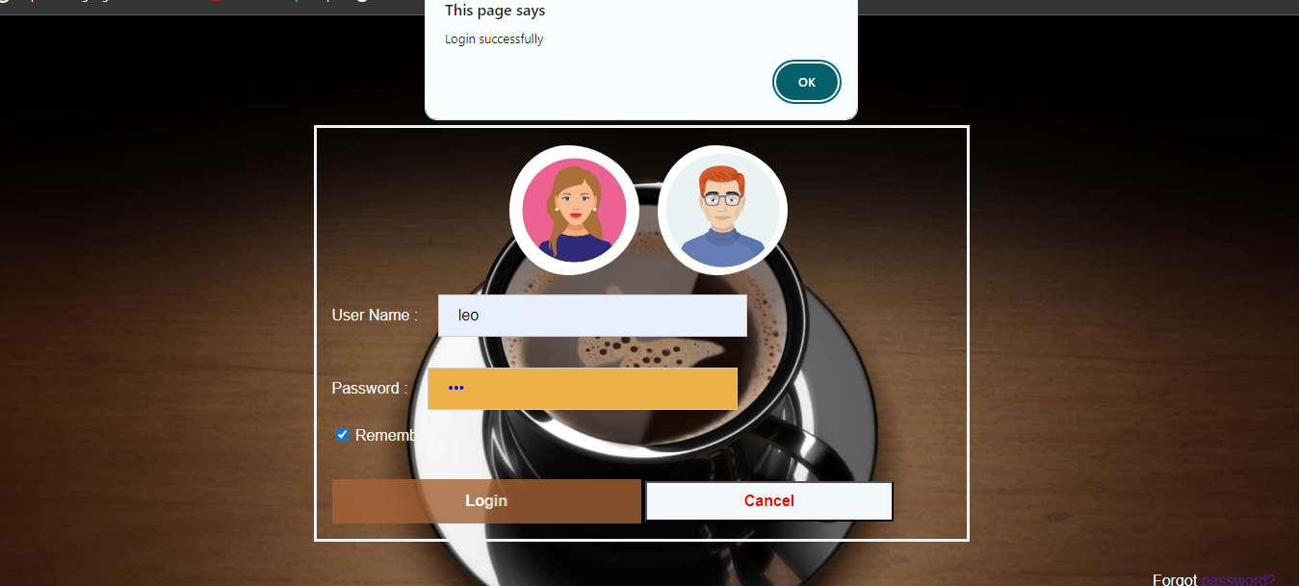

Slide 8
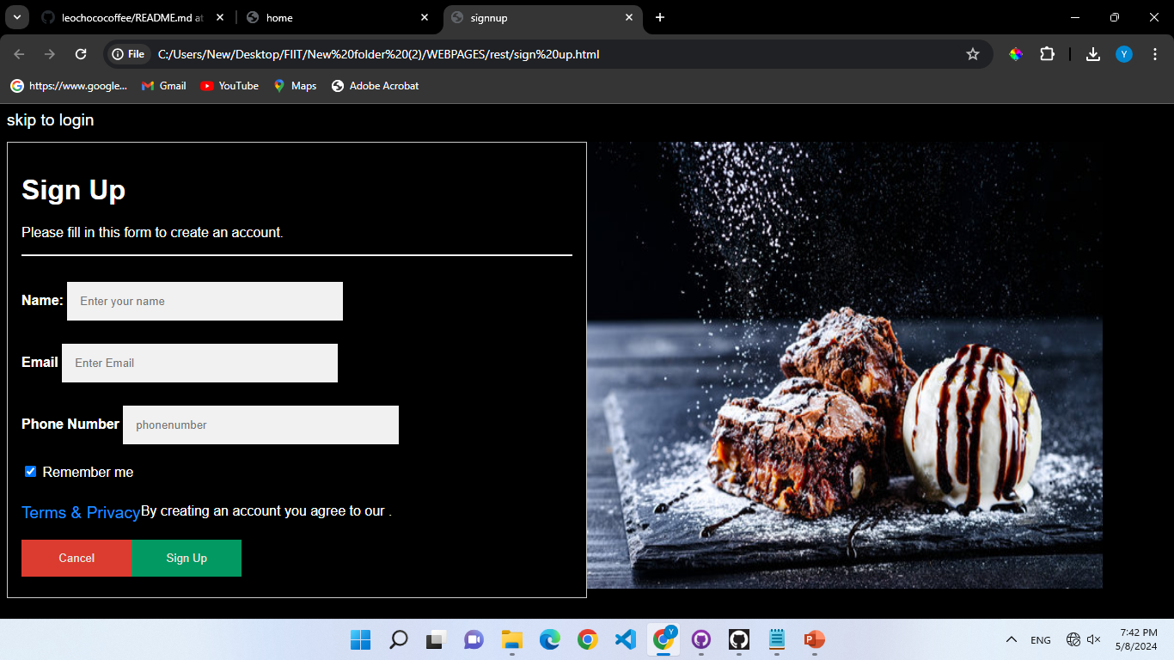

Slide 9
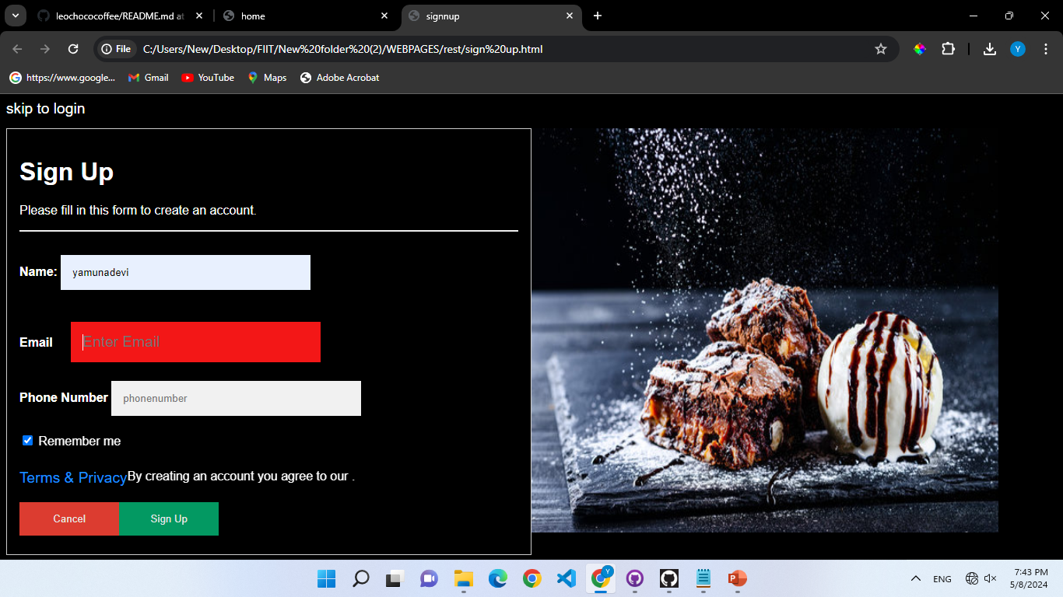

Slide 10
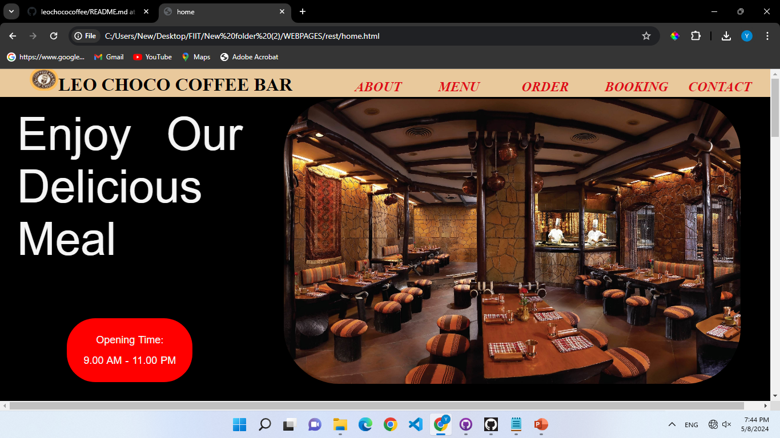

Slide 11
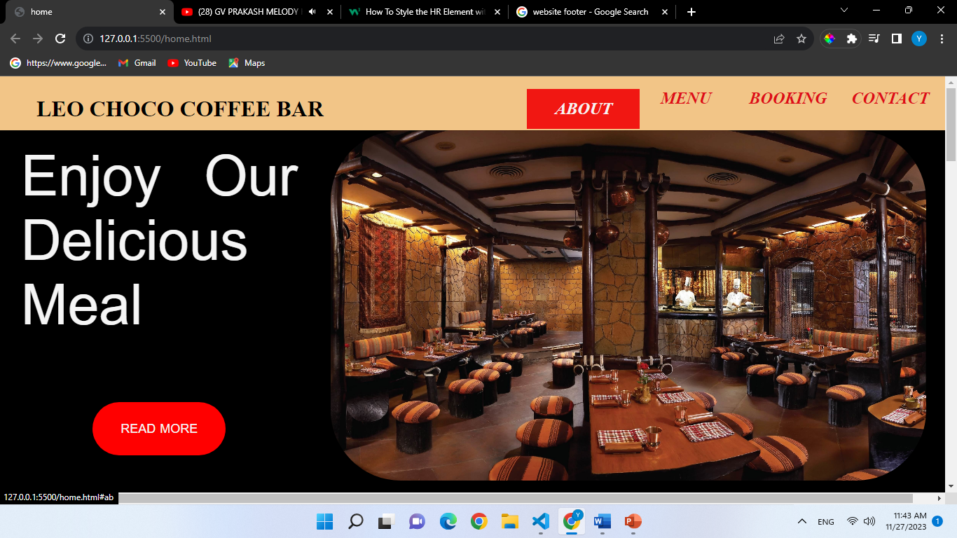
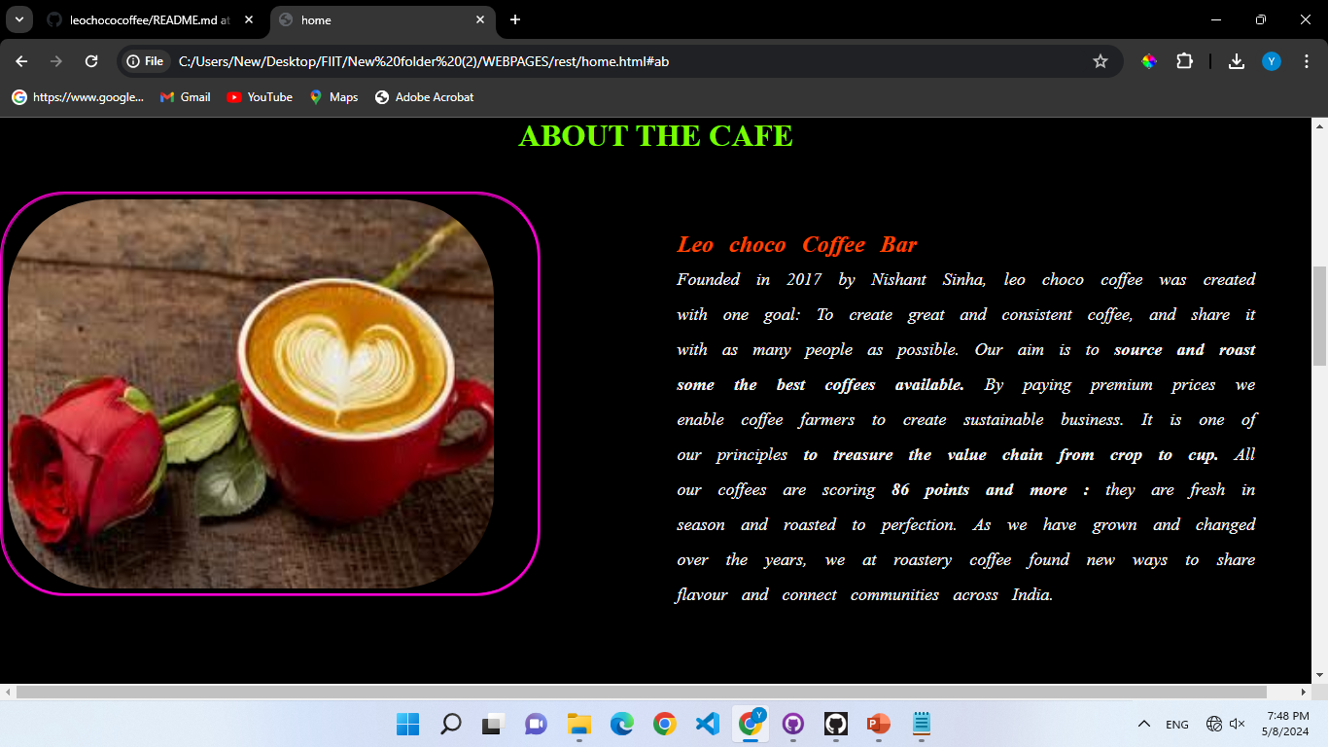

Slide 12
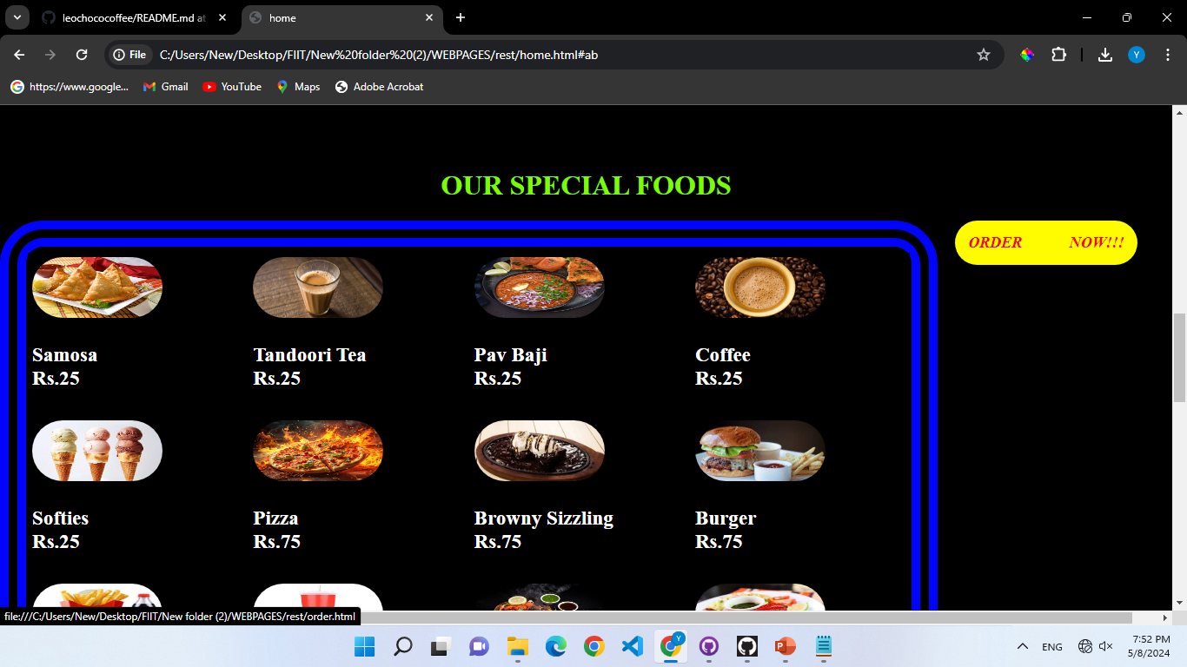
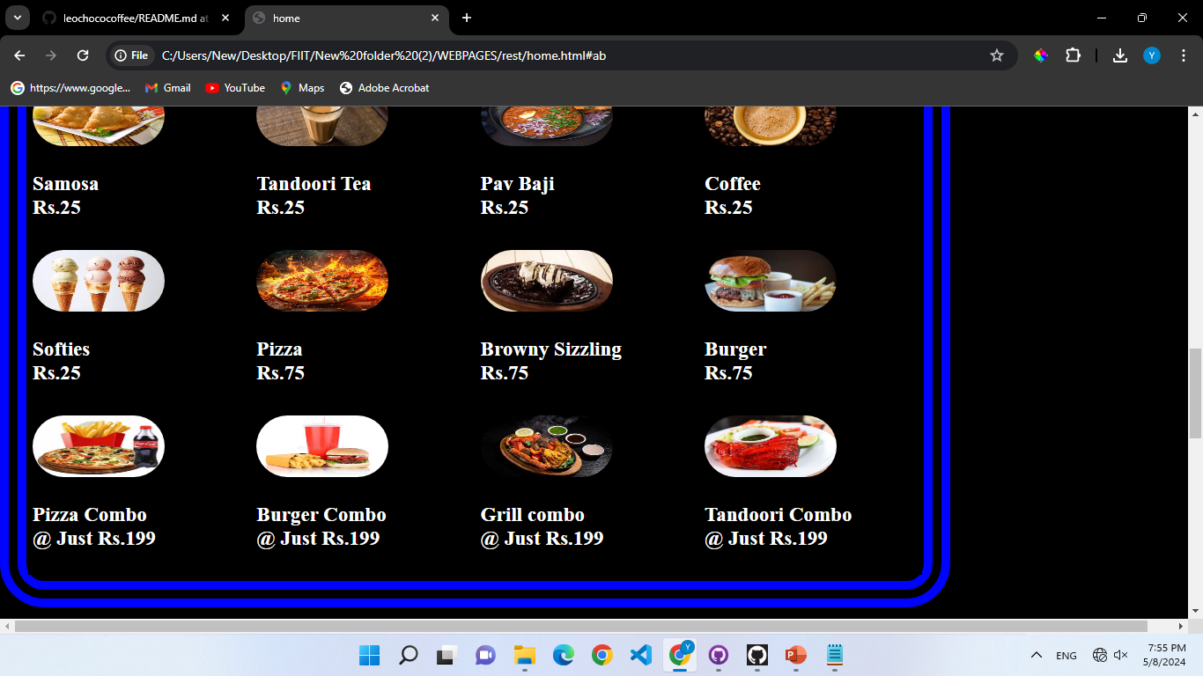

Slide 13
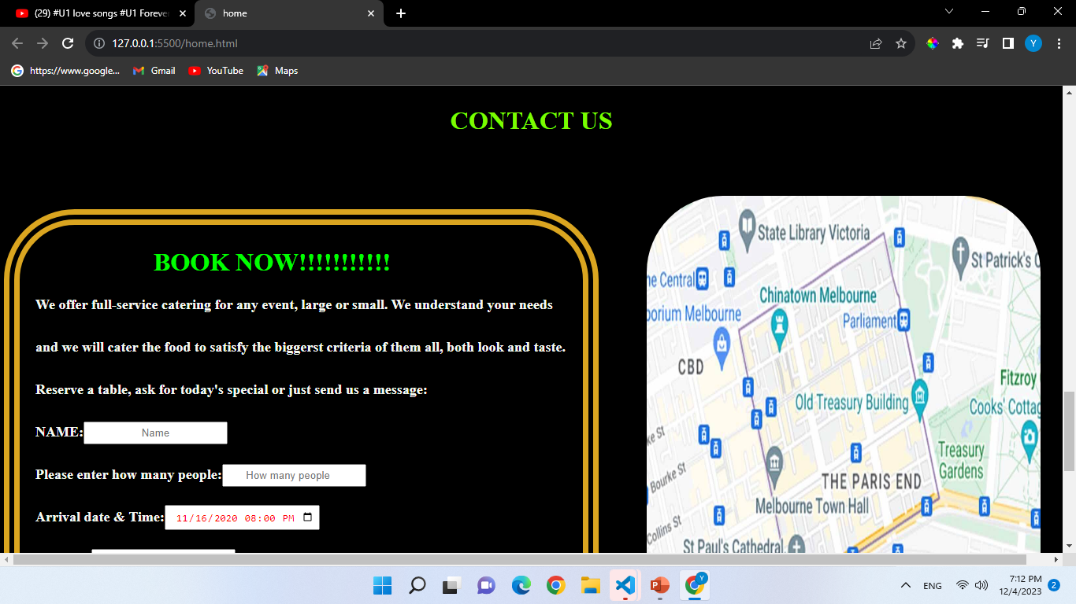
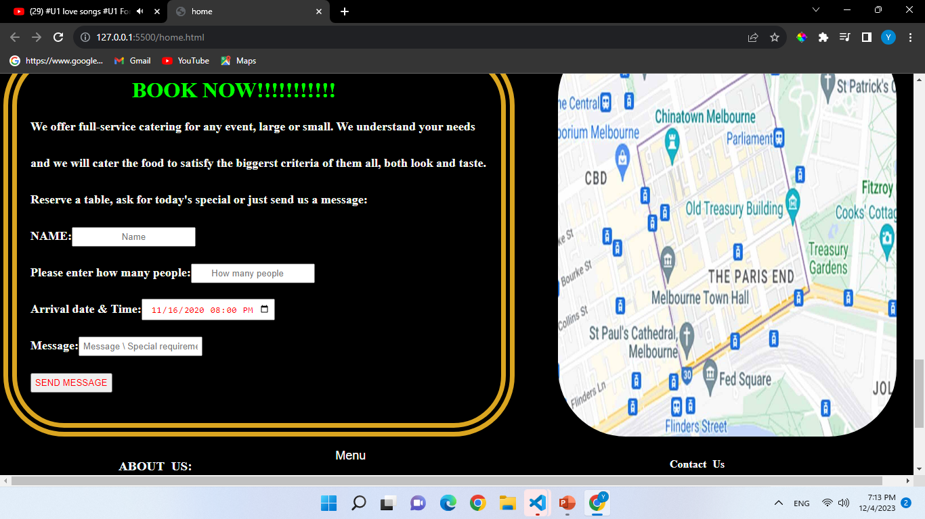

Slide 14
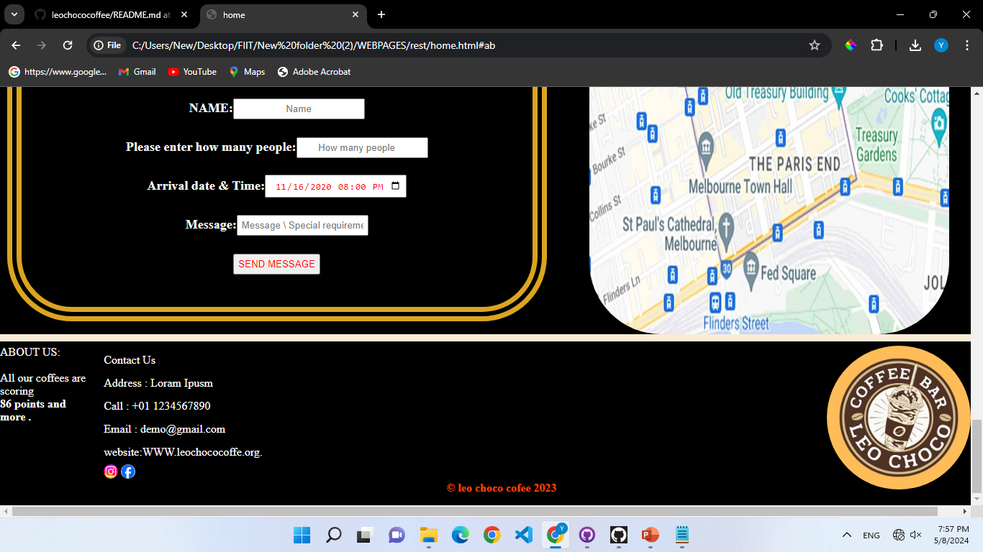

Slide 15
BOOKING PAGE

Slide 16
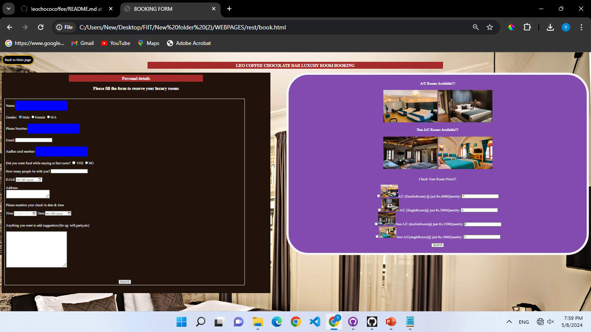

Slide 17
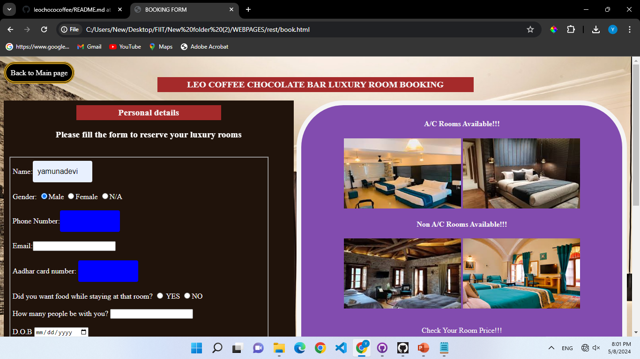

Slide 18
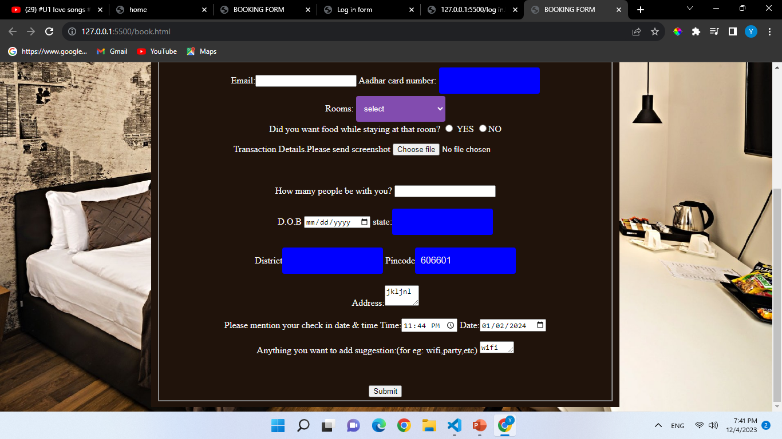
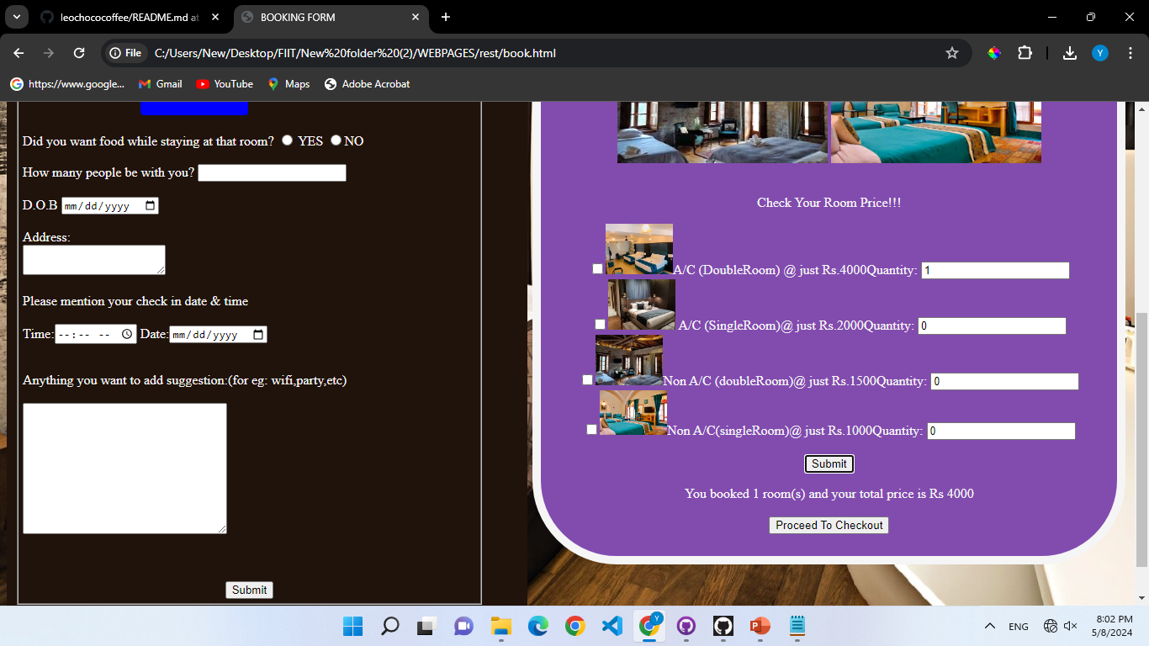

Slide 19
ORDER PAGE

Slide 20
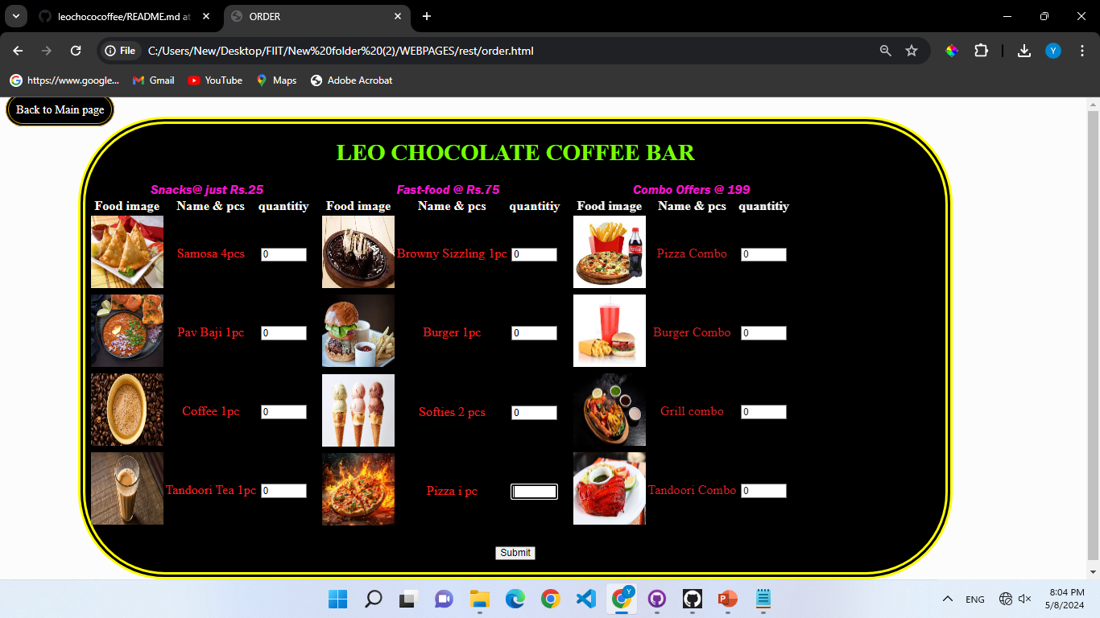

Slide 21
